Slide 1

SPECIAL OLYMPICS
COLLEGE CLUBS

Slide 2
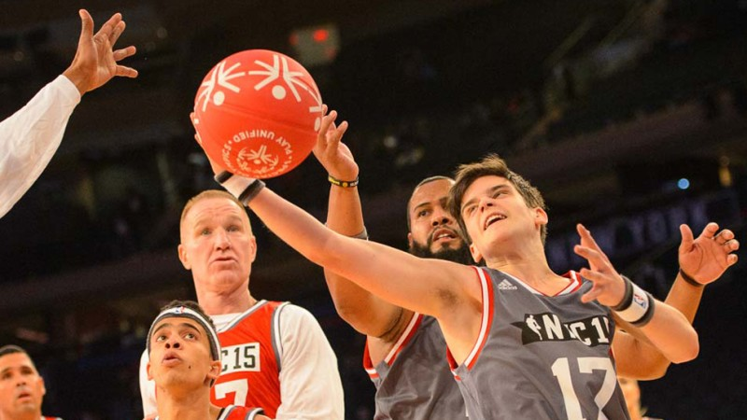

SO COLLEGE CLUBS
Special Olympics College Club functions as an official club on campus and connects college students and individuals with intellectual disabilities (Special Olympics athletes) through sport to build friendships and build campuses of respect and inclusion
The purpose of SO College Clubs is to create a more inclusive community that allows for Special Olympics athletes and college students/faculty to develop a greater respect for one another

Slide 3
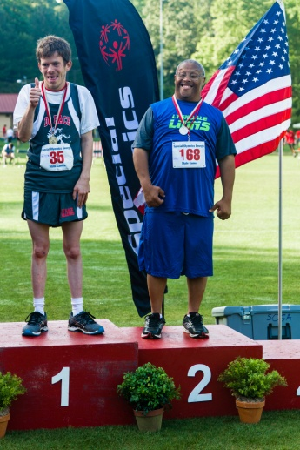
STRUCTURE
Special Olympics College Club programs are made up of three core elements: Unified Sports, Youth Leadership, and opportunities for Full Campus Engagement.
Together these components can help students work for and with Special Olympics athletes to help transform school campuses into communities of acceptance and respect.
Special Olympics Unified Sports®
Special Olympics Unified Sports joins students and Special Olympics athletes on the same team. It was inspired by a simple principle: training together and playing together is a quick path to friendship and understanding. In the context of a Special Olympics College Club, Unified Partners are college students without intellectual disabilities playing with Special Olympics athletes (individuals with an intellectual disability). At many schools Unified Sports functions as an intramural or club sport on campus, and at advanced levels this becomes tournaments with other local Special Olympics College Clubs.
Inclusive Youth Leadership
A Special Olympics College Club functions as an officially registered student-led club on campus, where students meet multiple times a month to plan events. This club is most effective when Special Olympics athletes are invited to become members. Students plan and organize all Special Olympics events on campus.
Whole Campus Engagement
Awareness Campaigns bring the whole college community together. Pledge signing drives, like Spread the Word to End the Word®, and rallies for respect can engage the whole student body. All students can be fans in the stands at local games, cheering on the participants. Whole School Engagement is a great entry point to introduce more students to the Special Olympics movement.

Slide 4
HOW TO START A CLUB
CONNECT WITH SPECIAL OLYMPICS GEORGIA - Formalize a relationship with Special Olympics Georgia. If assistance is needed connecting with the local program, email Logan.Gross@SpecialOlympicsGA.org
REGISTER ON THE SPECIAL OLYMPICS COLLEGE CLUB WEBSITE - Visit the Special Olympics College Club site and complete the application through SOGA
  https://www.sogaucs.com/so-college-1
CONTACT YOUR STUDENT ACTIVITES OFFICE - The Student Activities Office will be able to assist in the process of becoming a registered student organization on campus
ESTABLISH AN EXECUTIVE BOARD - Fill the positions of President, Vice President, Secretary, and Treasurer to help with the planning and implementation of the club
GET OTHERS INVOLVED AND RAISE AWARENESS ON CAMPUS - Set up an informational table on campus to raise awareness. Host a general interest meeting. Connect with other clubs/organizations on campus
DECIDE WHAT KIND OF EVENT(S) TO HOST - Download and review the Special Olympics College Club Event Guide. Start planning events
7. RESOURCES - Use others as a resource. Don’t be afraid to collaborate with other Special Olympics College Clubs nearby. Connect with Special Olympics online for additional resources.

Slide 5
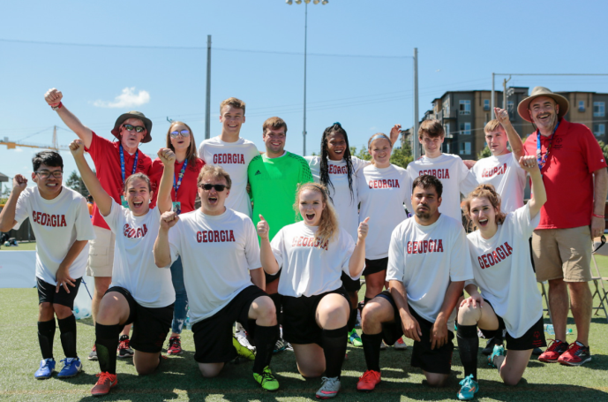
WAYS TO GET CONNECTED
Start a club- Create a team of leaders
Student Activities Department
Recreation & Intramurals
Host a State Invitational
Spread the Word Inclusion Campaigns
Fundraisers- Road races, raffles, etc.
Volunteer at local and state events
Connect Special Olympics athletes with Athletics Department
Greek organizations with Special Olympics as their national philanthropy: Phi Sigma Kappa, Alpha Sigma Alpha and Sigma Tau Gamma.

Slide 6
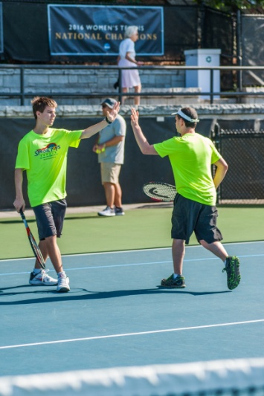
CURRENT SO COLLEGE CLUBS
University of Georgia
Emory University
Georgia Southern University
EAGLE Academy
Columbus State University
Berry College

Slide 7
RESOURCES
SO College Clubs Website
https://www.sogaucs.com/so-college-1
https://www.specialolympics.org/our-work/unified-schools/college
http://www.specialolympicsga.org/become-an-athlete/so-college/
Download the application on the SOGA website
SO College Starter Guide for ideas (pages 6-8 in particular). The Sky is the limit! http://media.specialolympics.org/resources/community-building/youth-and-school/so-college/Special-Olympics-College-Club-Starter-Guide.pdf
Branding Guidelines
https://media.specialolympics.org/resources/community-building/youth-and-school/so-college/SO-College-Clubs-Guideline-v1-0.pdf
Event Guide
Special-Olympics-College-Event-Guide-2019_compressed (1).pdf

Slide 8
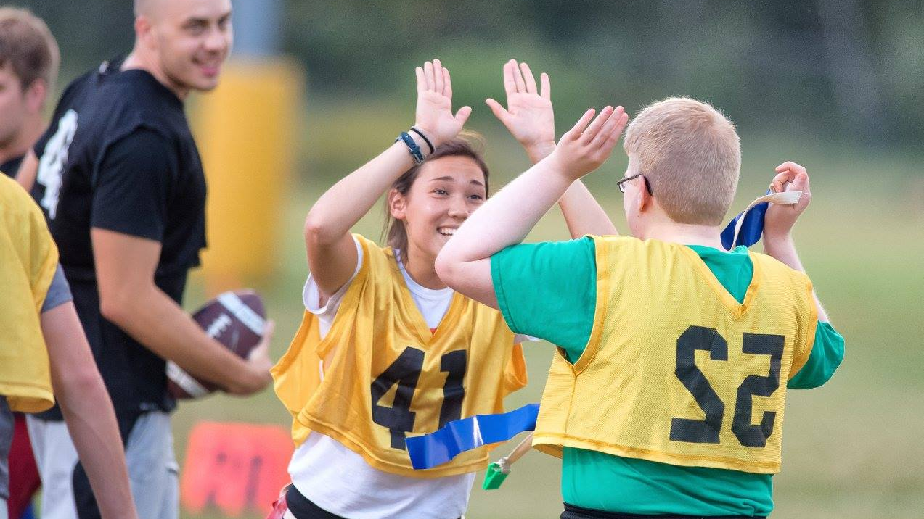
THANK YOU!
For more information on starting an SO College Club or getting involved with a current SO College Club,
please contact:
Logan Gross
(770) 414-9390 ext. 1109
Logan.Gross@SpecialOlympicsGA.org

